Slide 1
Microcalcification detection, clustering and features extraction
Presentation of 17/07/2023

Slide 2
I) Background, reminder of last meeting
Two solutions
Input of HPV, table of comparison
II) Superimposition and criticism of the model presented last time
III) Trying out a new, simple way of making clusters
New pre-treatment
Simple way based on distance and pre-fixed numbers of clusters
Advances on characteristic list for HPV step 2 (solution 2)
IV) Conclusion and opening

Slide 3
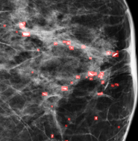
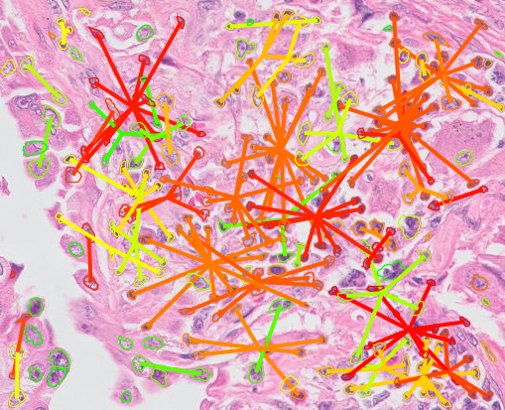
I) Background, reminder of last meeting
Last time :
2 Algorithms : CALC1 and HPV (step1: segmentation and step 2: clusterisation),
both running separately
Study of inputs and outputs of both codes
2 Solutions proposed : start HPV on step 1 or on step 2
First solution adressed not the second yet
Table of comparison of both solution
Settled objectives :
Make progress on second solution
Superimpose first solution output on mammogram and criticize
Try new, more simple ways to form clusters directly from CALC1 output
CALC1 output
HPV output with nuclei entry

Slide 4
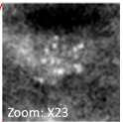
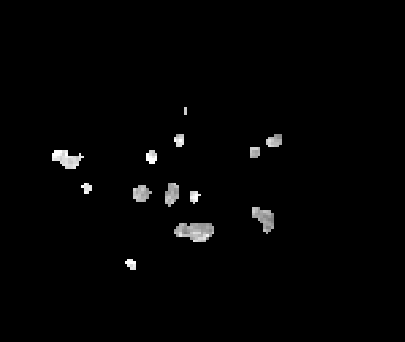
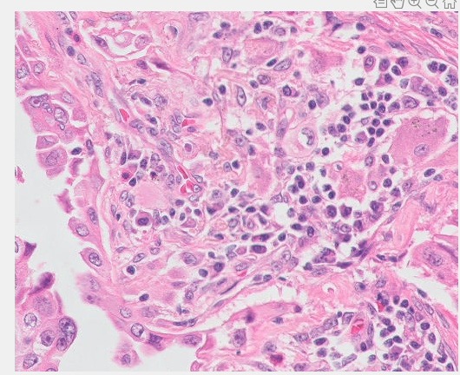
1) The two solutions proposed
CALC1
Microcalcification detection
First Solution:
Adapt CALC1 output and step1 code
Second Solution:
Obtaining compatible properties and structures
HPV - Step 2
Grouping in cluster & computing characteristics on clusters
-List of compatible properties
-List of nuclei
HPV - Step 1
Dots segmentation & Characterisitics

Slide 5
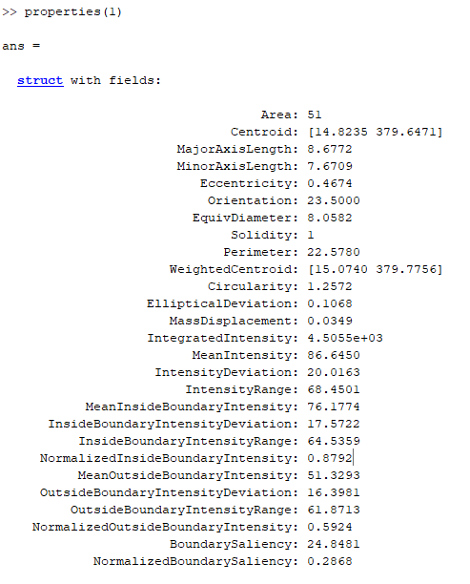
2) Input of HPV for step 2 and table of comparison
Method considered | Issues | Shortcomings / Advantages | Current state of the code | Opportunities for improvement
Merge on Step 1 | - Watershed morphology algorithm -> parameters tailored for nuclei - Adapt output of CALC1 | - Impossible if strong apriori in step 1 + Greater characteristic coherence | - Tried to adapt the output of CALC1 - Not yet delve into Watershed paramaters | Try to adapt the parameters of watershed
Merge on Step 2 | - Hard to get the properties list by the same way | + avoiding detection error from step1, - Less coherence | - Not implemented

Slide 6
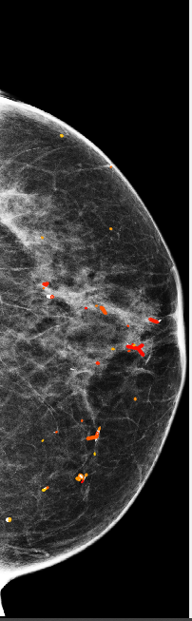
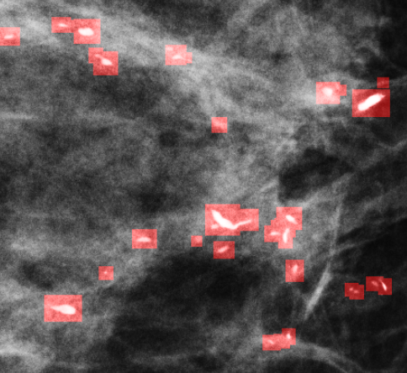
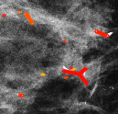
II) Superimposition and criticism of the first solution presented last time
Output of first solution and little zoom
Microcalcifications before clustering in the same area

Slide 7
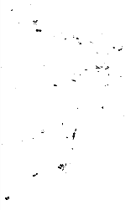
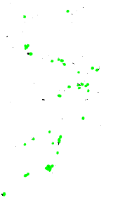
Probably the error occurs on segmentation (step 1) and not clusterisation (step 2):
Possible causes:
low density of calcifications compared to nuclei?
Shapes a bit different?
Background different?
(zoom) Output of CALC1 and input of step1
(zoom) Output of step1

Slide 8
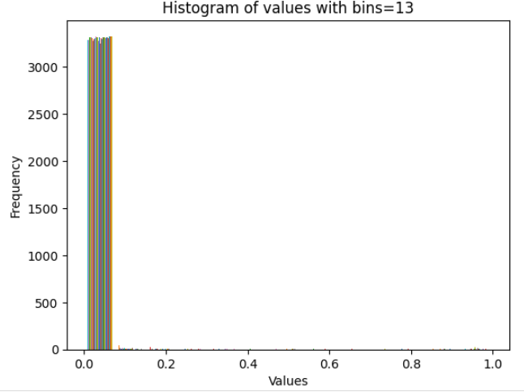
III) Trying out a new, simple way of making clusters
1) New pre-traitement
imbin2 = scipy.ndimage.binary_fill_holes(imbin2) * 1
->filling the holes to improve the continuity of objects or regions, making them easier to manipulate and analyse later.
Histogram of the output of CALC1 pre-traitement to find a more accurate threshold value for binarisation

Slide 9
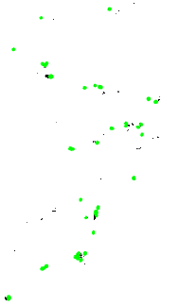
New modified Output of step1
Old modified Output of step1
Output of Calc1

Slide 10
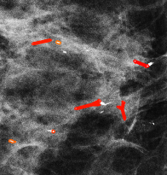
Output of step 2 with new modified output of CALC1
Output of step 2 with previous modified output of CALC1
Microcalcifications before clustering in the same area

Slide 11
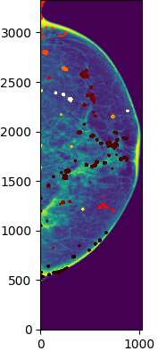
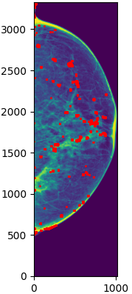
2) Simple way based on distance and pre-fixed numbers of clusters
Simple clusterisation of calcification regions based on distance and pre-defined numbers of clusters: 20
Mammogram image with calcifications to compare with

Slide 12
3) Advances on characteristic list for HPV step 2 (solution 2)
-Show code and table

Slide 13
IV) Conclusion and opening
Threshold value and probability of calcification of CALC1?
Is first solution not a good one?
Trying to make clusters only on distance and not numbers of clusters + distance?

